Slide 1

Data Bootcamp Final Project Presentation
COVID-19 and Education:
COVID-19, its impact on students’ health and their time spent on education.
By Mary Akpeki

Slide 2

About Me
My name is Mary Akpeki and I am a 24 year old Rights Assistant in publishing. I studied psychology at the University Of East London and achieved a First. I recently decided to upskill and train to be a Data Analyst. I enjoy going to the gym and reading books.
Notes:
….I am excited about graduating from the Data Analytics boot camp.

Slide 3
My Project - Objectives
Average time spent on online class
The link between health issues and time spent on online classes
Comparison between time spent studying online and studying independently
How students’ access to technology impacts their learning time

Slide 4

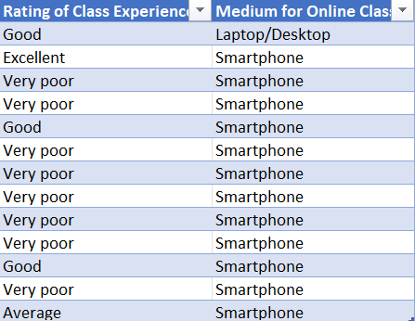
My Project - Excel Findings
The average amount of hours spent on online study is
This table is a VLOOKUP representing the students’
rating of their class experience and the
medium they used for online study.

Slide 5
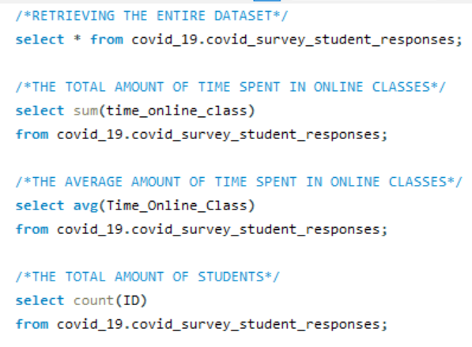
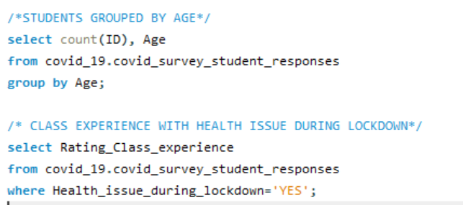
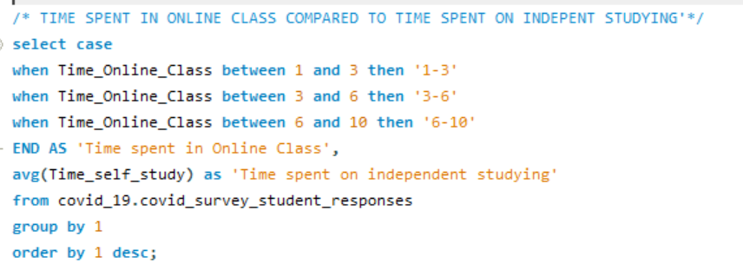
My Project - SQL Analysis

Slide 6
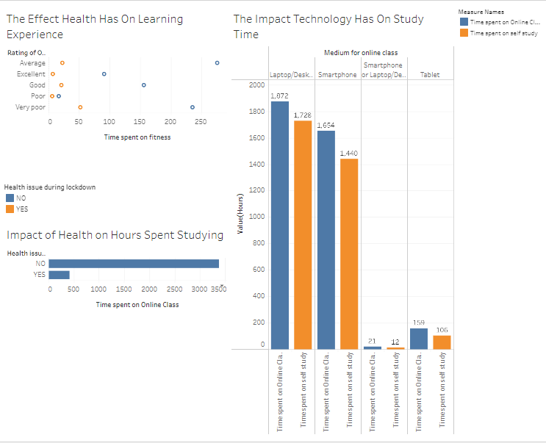
My Project - Dashboard

Slide 7



My Project - Recommendations/Insights
Kids need better access to devices
Ensure they are kept fit healthy and maintained and is a priority
Being healthy positively effects time spent on studying
Despite negative health people still had positive rating on their in online class experience
Time spent on independent study correlates with time spent in online class

Slide 8
Challenges
Making time for outside study
Balancing this with a full time job
Becoming more confident with SQL
Adapting to a new network of people I had never met

Slide 9
Conclusion and Key Learnings
I recently decided to upskill and train to be a Data Analyst. I have always enjoyed the statistical element during my degree and wanted to widen my knowledge in this area further. For my dissertation I gathered and analysed data into the perceptions of cyberstalking on social media and have a great interest in observing behaviours. I aim to graduate from this course and go on to become a Data Analyst in the tech industry I have learnt so much about Data Visualisation and presentation, I have become more disciplined and I have become more attentive to details for example when looking at reports at work I am more attentive to details to ensure accuracy. It can be difficult facing a concept that you have never encountered before but throughout this course I have learned that if you do not try and fail you will not succeed.

